Slide 1
Red
Herring
By: Calvin Crino
Matthew Sutton
James Bors

Slide 2
A brief lesson in
Steganography
Greek:
Steganos - "covered, concealed, or protected"
Graphein - "writing"

Slide 3
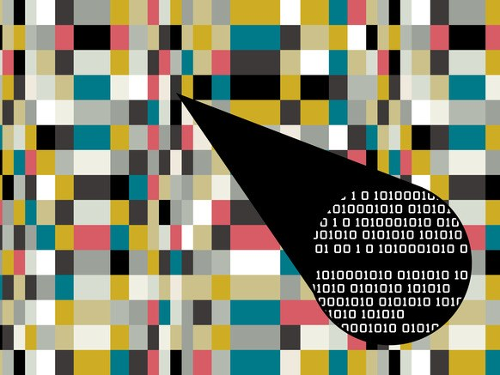
The Basics
Image credits: hotlittlepotato, Instagram
-The words we type and the pictures we view are all composed of binary.
-With steganography, we can combine the two to hide a message into a picture with almost no trace.

Slide 4
Steganography and its uses
Steganography allows us to hide all kinds of cool stuff into pictures
While we have chosen to encode strings, it can also be used to hide other pictures or files themselves.
The size of the message/picture/file we choose to encode relies heavily on the encoding method and the image quality desired after encoding.
The best image quality obtainable after encoding is achieved by only manipulating a single bit per pixel, but this comes at the cost of decreased encoding density (the amount of “hidden” data in the picture).

Slide 5
The BMP Format
offset | size | description
0 | 2 | signature, must be 4D42 hex
2 | 4 | size of BMP file in bytes (unreliable)
6 | 2 | reserved, must be zero
8 | 2 | reserved, must be zero
10 | 4 | offset to start of image data in bytes
14 | 4 | size of BITMAPINFOHEADER structure, must be 40
18 | 4 | image width in pixels
22 | 4 | image height in pixels
offset | size | description
26 | 2 | number of planes in the image, must be 1
28 | 2 | number of bits per pixel (1, 4, 8, or 24)
30 | 4 | compression type
34 | 4 | size of image data in bytes (including padding)
38 | 4 | horizontal resolution in pixels per meter
42 | 4 | vertical resolution in pixels per meter
46 | 4 | number of colors in image, or zero
50 | 4 | number of important colors, or zero
We are interested in
The image width - offset 18
The image height - offset 22
The color depth - offset 28
All of these are used for checks and calculations during both encoding and decoding of images.

Slide 6
The anatomy of a 24 bit color depth pixel
The 24 bits are split into 3 groups, 8 bits for each color
We are interested in the last of the 8 bits in each color, or the
Least Significant Bit (LSB)
We manipulate this bit so that it matches the corresponding bit in our message, and repeat the process until we are out of message bits to encode
Or, if we are decoding,
We read the last bit into a message buffer and repeat until we reach an encoded null character

Slide 7
The idea:
We are hiding the bits of a message, in binary, inside the pixels of a picture.
To do this, we need to load in a picture byte by byte and change the least significant bit in each of those bytes.
We will continually do this until we either:
Encode a null character or,
Run out of room in the picture
An example of the chromatic LSB encoding method is on the following slide

Slide 8
Encoding
Example
R | G | B
0 0 1 1 1 1 1 0 | 1 0 0 1 0 1 0 1 | 1 0 0 1 1 1 1 1
0 1 0 1 0 0 1 0 | 0 0 0 0 0 0 0 0 | 1 1 0 1 1 1 1 1
1 0 0 1 0 1 1 1 | 1 0 0 1 0 0 1 1 | 0 0 0 0 1 0 0 0
0 1 1 0 0 0 1 0 | 1 0 1 1 1 0 1 0 | 0 1 0 1 0 0 1 1
0 1 1 1 0 1 0 1 | 0 1 1 0 0 1 1 1 | 1 0 0 1 0 1 1 1
0 0 0 1 0 1 1 0 | 0 0 0 1 1 1 1 1 | 1 0 1 0 0 1 0 1
0 1 1 1 0 0 0 1 | 0 1 1 1 0 1 0 1 | 0 1 0 1 1 0 1 0
1 0 0 1 0 1 0 1 | 1 0 1 1 0 0 1 0 | 0 0 0 1 1 1 1 0
0
1
0
R - 01010010
G - 01000111
B - 01000010
1
0
0
1
0
0
1
0
0
0
1
1
1
0
1
0
0
0
0
1
0

Slide 9
Encoding methods
Chromatic LSB
Use each color in each pixel in order to store the message.
Insecure, Great information density
Monochromatic LSB
Pick a color: red, green, or blue and encode the message in that channel’s LSB’s.
Slightly more secure, near perfect image quality, only one channel effected
Keyed Monochromatic LSB
Provide a key and the program will pseudo-randomly select a single channel from each pixel to store the message bit in.
Much more secure than non-keyed methods, Great image quality
Keyed Chromatic LSB
Provide a key and the program will pseudo-randomly select an permutation of channels from the pixel to store the LSB’s in. ex rgb, grb, brg
More secure than all other options, Great information density

Slide 10


This is a comparison between an unedited picture and a picture with all of the text on this slide encoded into it. As you can see, an encoded message can go completely undetected.
Image credits: mariomayhem.com

